Slide 1
carbohydrates

Slide 2
Carbohydrates and Biochemistry
• Carbohydrates are compounds of tremendous biological importance: – they provide energy through oxidation – they supply carbon for the synthesis of cell components – they serve as a form of stored chemical energy –, proteins, nucleic acids, and other compounds are known as biomolecules because they are closely associated with living organisms. Biochemistry is the study of the chemistry of biomolecules and living organisms. they form part of the structures of some cells and tissues • Carbohydrates, along with lipids

Slide 3
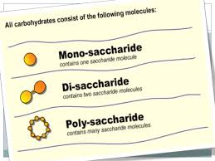

Slide 4
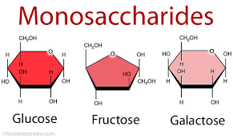
A monosaccharide is the most basic form of carbohydrates. Monosaccharides can by combined through glycosidic bonds to form larger carbohydrates, known as oligosaccharides or polysaccharides. An oligosaccharide with only two monosaccharides is known as a disaccharide. When more than 20 monosaccharides are combined with glycosidic bonds, a oligosaccharide becomes apolyccharids. Some polysaccharides, like cellulose, contain thousands of monosaccharides. A monosaccharide is a type of monomer, or molecule that can combine with like molecules to create a larger polymer.

